Slide 1
Learn Python 16
Vishal Yelisetti

Slide 2
Agenda
Commands from last week
Joke
Tkinter terminology
Joke
Creating 1st Tkinter UI
Homework – maybe
Joke

Slide 3
GUI – Graphical User Interface
Widget - denotes things like windows, buttons, pulldown menus, checkboxes, etc. Widgets are graphical user interface components
Container - The container is just a container into which we can put widgets. One example of container is ‘Canvas’
Frame - the frame is a container into which we can put widgets
Events - GUI program will take some action as a result of the mouse click, or a key press of keyboard like ENTER, or UP, DOWN arrow keys
Event Handlers - The part of the program that takes actions in response to the events
Bind - The process of association of widget with the event handler and the event

Slide 4
Code Terminology
Root (Parent) - top-level container
Child - widget that is placed in the container is called ‘child’ of the container
Attributes - All widgets have several attributes such as background color, foreground color, size, font type, font face (italics, bold, etc.), and the size of the text written on top of the widget
Geometry Manager
grid – Arranges widgets in a grid, like a graph paper with horizontal and vertical lines
pack – Packs widgets into a cavity, makes widget visible on the screen
place – Positions widgets at absolute locations
Mainloop() - continuously watches all events that happen while the program is running such as key press, mouse clicks, etc

Slide 5
Steps for Tkinter GUI
Import tkinter module
Create a “top level” window. This top-level window (called ‘root’) is the highest-level GUI component in a Tkinter application. In the below program, the statement root = Tk() creates the top-level window ‘root’.
Create an instance of Frame class. In the below example, the statement frame1 = Frame(root) creates an instance of Frame class, and is named ‘Frame1’, which is now a child of parent ‘root’.
Run pack method on ‘frame1’ instance. See program statement frame1.pack()
Create an instance of the widget class and associate it with the parent ‘frame1’. In the below program, ‘button1’ is an instance of Button class. ‘button1’ is now a child of parent ‘frame1’.
Set widget’s attributes (such as color, size) corresponding to the widget
Pack the widget to size itself.
‘root’ object has a method called ‘mainloop’. The last statement in the creation of the application operates the ‘mainloop’ method on the ‘root’ object. The ’mainloop’ method runs continuously (unless stopped by the user) and waits for events to occur in ‘root’. (We will discuss ‘events’ in a later section). The statement root.mainloop() is a method that is executed if we want to run our application. root.mainloop() method will run continuously forever, waiting for events to occur, such as user clicking the mouse. root.mainloop() will exit if the user exits the program by closing the window.

Slide 6
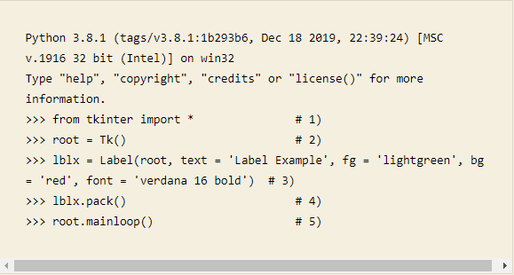
Label
from tkinter import *: In any tkinter app, the first step is to import the Tkinter module. This statement imports the tkinter module along with Tk() toolkit. This module contains all classes, functions, etc. needed to work with the Tk toolkit.
root = Tk(): Next step is to initialize Tkinter. This is done by creating a Tk root widget. root = Tk() statement initializes the tkinter module and creates a Tk root widget, which is simply a window with a title bar, with close icon (x), minimize icon (-), and maximize icons. Root widget must be created before any other widgets. Root is the highest-level widget in the application. All other widgets are children of the root widget. If you execute the root = Tk() statement, you will see a window with a title bar on your desktop with the maximize, minimize, and close ixons.
lblx = label(parameter 1, parameter 2,……) This step creates an instance of the Label class and names it ‘lblx’. (You can choose any name you like.) There are parameters within the parenthesis. The first parameter must be the parent widget – in this case ‘root’ that we created in step 2). This statement makes instance ‘lblx’ a child of parent ‘root’. In this step, we also set attributes how we want to make the label widget look by using keyword parameters and attributes as below:
lblx.pack(): In step 4, we use the pack method on object ‘lblx’. The pack method stretches or shrinks the label widget to fit the text and makes the widget visible. Before this step, you will not see the widget; you will just see the window you created in step 2). When you enter pack() on your keyboard, you will notice the window you created in step 2 shrink to the size of the text you entered in step 3).
root.mainloop(): Finally, in step 5), we run the method ‘mainloop’ on object ‘root’ to run our application, we just wrote. mainloop() continues to run the application, waiting for an event to occur and process the event as long as the window is not closed. This event loop handles all events from the user (keyboard key press, mouse clicks etc.). Note: In this example, we do not have any events; we will write programs that handle events in the following sections. mainloop() method runs continuously until you (the user) close the window

Slide 7
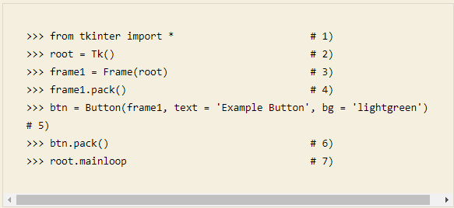
Button
This step is the same as the Label program done earlier.
This step is the same as the Label program done earlier.
This step is the same as the Label program done earlier.
frame1 = Frame(root): In this step, we create an instance of container Frame and name it ‘frame1’and associate it with ‘top’ level (root). ‘frame1’ becomes a child of parent ‘root’. As described earlier, Frame class is a container widget used to put other widgets like buttons inside it in the application program’s layout. In the following steps, we will put our button widget in container called ‘frame1’.
frame1.pack(). In this step, we run the pack method on ‘frame1’ object instance. The bigger window you saw after step 2) will become small and will showing just the window heading, maximize, minimize, and close icons.
btn = Button(frame1, text = ‘Example Button’, bg = ‘lightgreen’). in this step, we create an instance of Button class and name it ‘btn’. In the parenthesis, we use three parameters. The first parameter always needs to be the parent (in this case, it is ‘frame1’). Thus, ‘btn’ is a child of parent ‘frame1’. The second parameter is the text we would like to write on the button (‘Example Button’ in this case). The third parameter is background color of the button. We chose ‘lightgreen’ option for this parameter.
btn.pack(): We run the pack method on object ‘btn’. The button will shrink or expand to the size of the text.
root.mainloop: Finally, we run the event loop, which runs continuously watching for events. In this program, we do not have any events, so the event loop will keep on running until stopped by the user. Clicking the button with a mouse will not do anything.

Slide 8
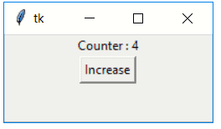
Homework
Create a Label
Increase: 0
Create a button called increase
Function to increase the counter
def increase(): # Function to increase the value of counter
global COUNTER
COUNTER += 1
label_text.set(f"Counter : {COUNTER}")
Homework: Each time the increase button is clicked, increase the count by 1

